Slide 1

Spotted Python Week 3 Tutorial
Lists and Arrays
Functions
Logical Statements
Simple Graphing

Slide 2
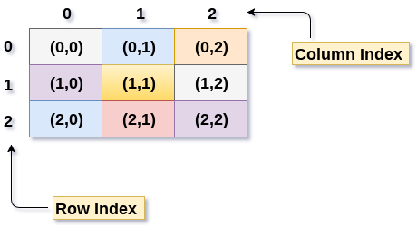
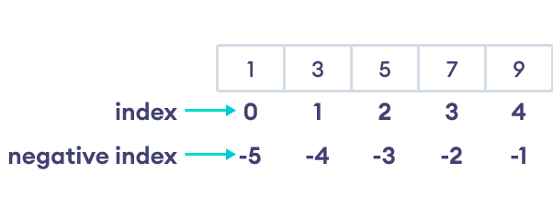

Lists and Arrays
https://github.com/mithebell/PHYS3116
Lists are a sequence of objects enclosed in [ ] and separated by commas
Arrays are an arrangement of numbers or objects formatted into rows and columns
Indexing:
Complete Exercise 1
Notice that indexing starts from 0

Slide 3
Functions
A set of instructions that will be repeated
Code written for a specific task. For example, calculating the gravitational acceleration
Complete Exercise 2

Slide 4
Logical and if-else Statements
Python can evaluate logical statements
==, >=, <=, !=, >, <
if statement executes a block of code (indented) if the given condition is True
else statement executes a different block of code, if the if condition is False
elif statement allows the execution of multiple conditions in sequence
Complete Exercise 3

Slide 5
Simple Graphing
Matplotlib is the most used tool for visualisation
Documentation: https://matplotlib.org/stable/
List of in-built colours: https://matplotlib.org/stable/gallery/color/named_colors.html
List of in-built colourmaps: https://matplotlib.org/stable/users/explain/colors/colormaps.html
Module to import alternative colourmaps: https://cmasher.readthedocs.io/index.html
Tool to create colourmap: https://gka.github.io/palettes

Slide 6
Group Meeting Time

